Slide 1
Practical Project
By Ridwan Kawsar

Slide 2
Technologies
Version Control System - Git
Source Code Management - GitHub
Kanban Board - Jira
Database - MySQL Server 5.7+ (local or cloud hosted)
Back-end Programming Language - Java
API Development Platform - Spring
Front-end web technologies - HTML, CSS, JavaScript
Static Analysis - SonarQube
Build Tool - Maven
Unit Testing - JUnit & Mockito
Integration Testing - JUnit
Automated Testing - Selenium

Slide 3
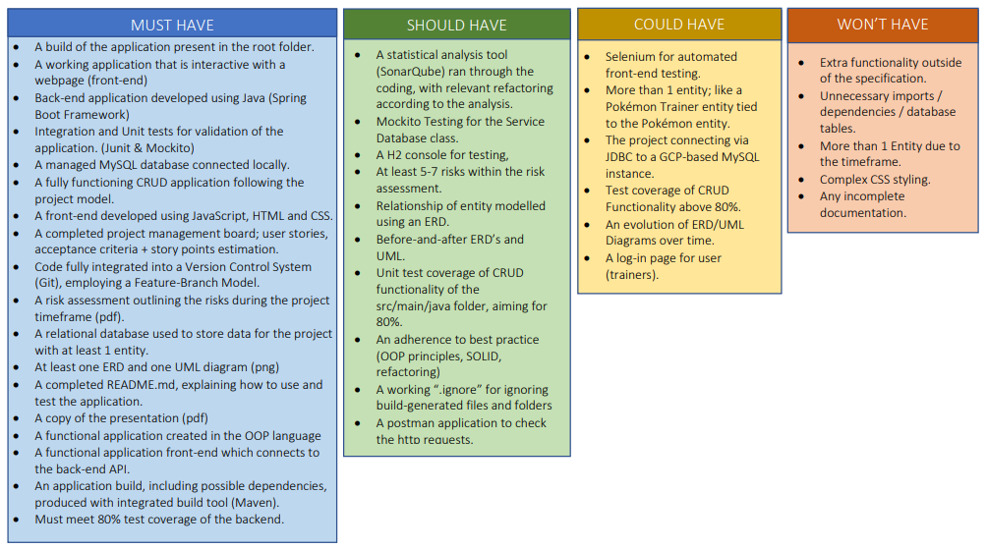
MoSCoW Prioritisation

Slide 4
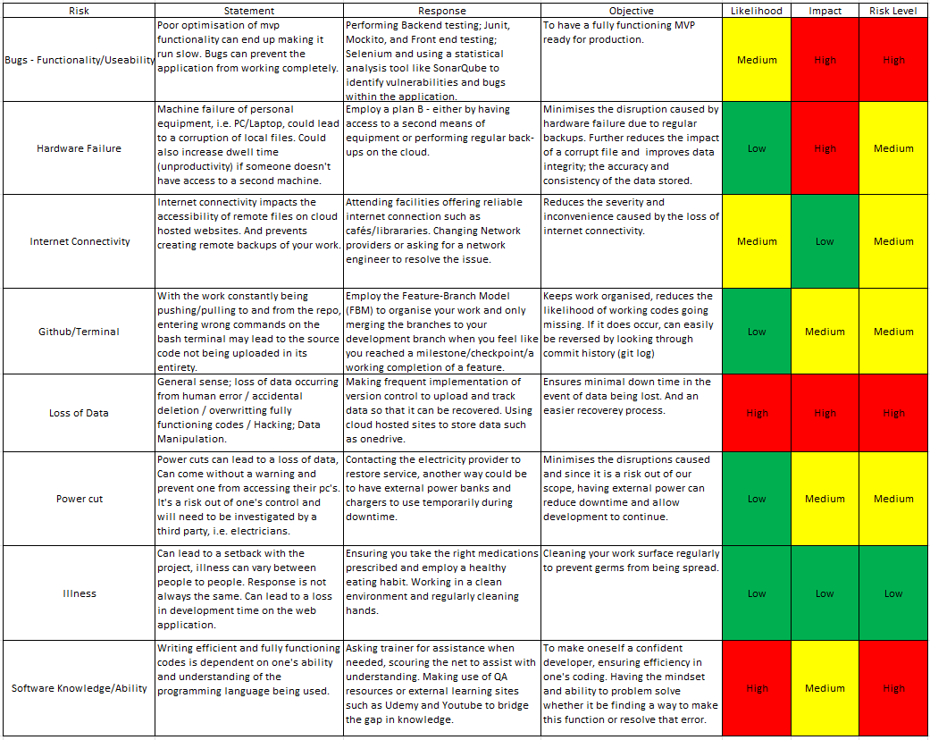
Risk Assessment

Slide 5
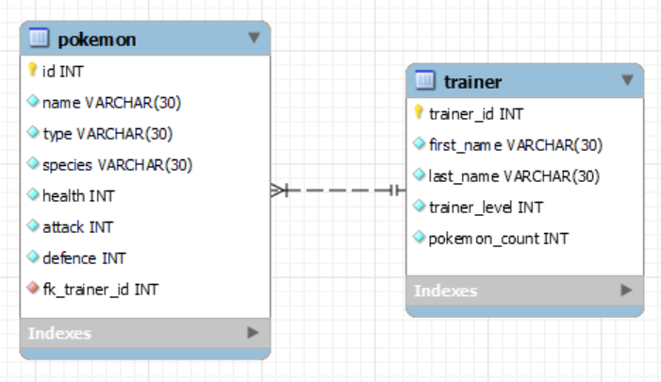
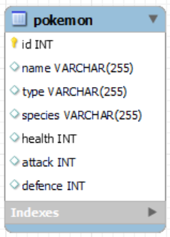
Entity Relationship Diagram (ERD) - Initial & Final

Slide 6
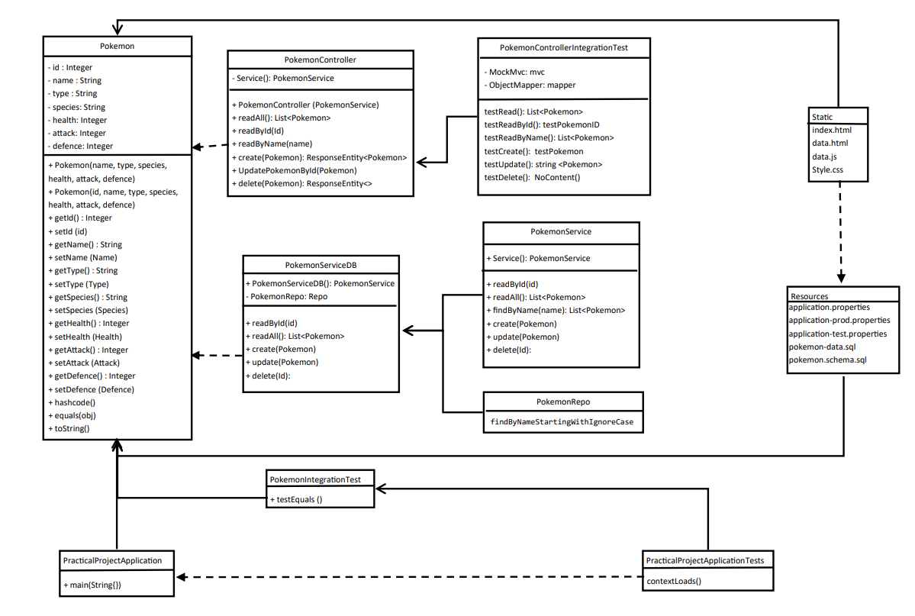
UML

Slide 7
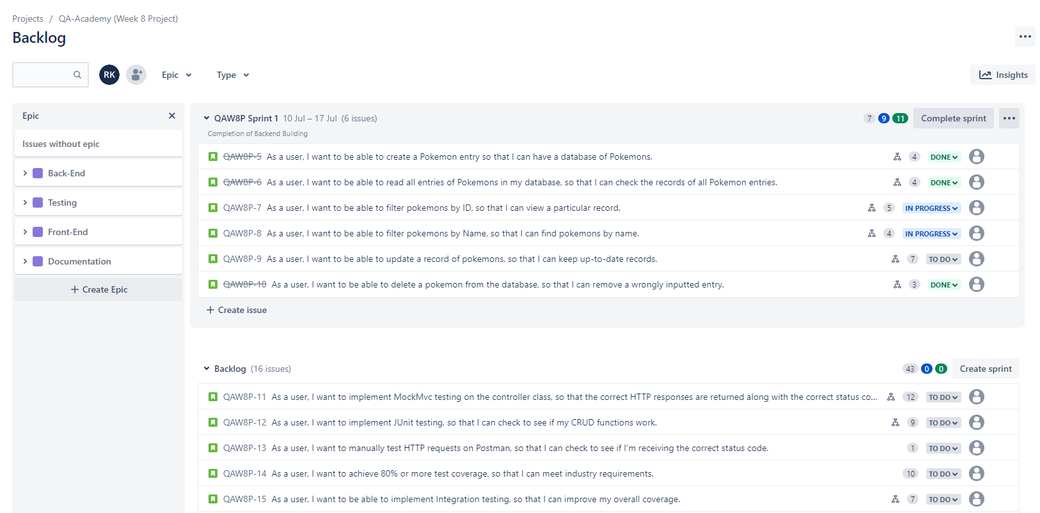
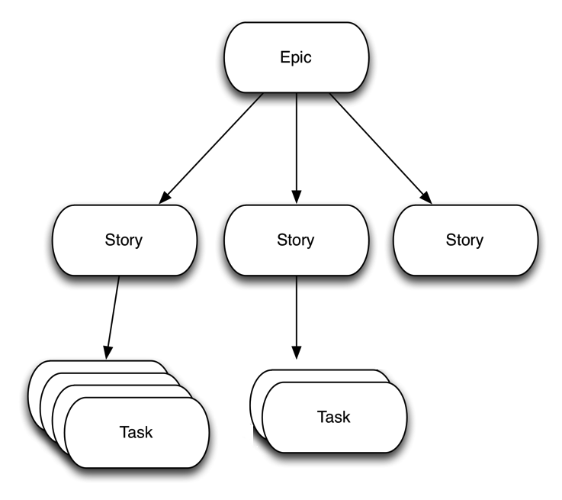
Jira Board – Epics/User Stories

Slide 8
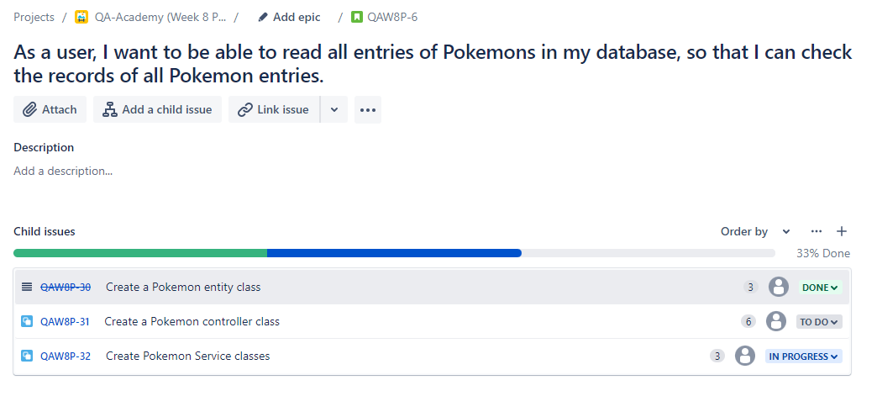
Jira Board – User Stories and Tasks

Slide 9
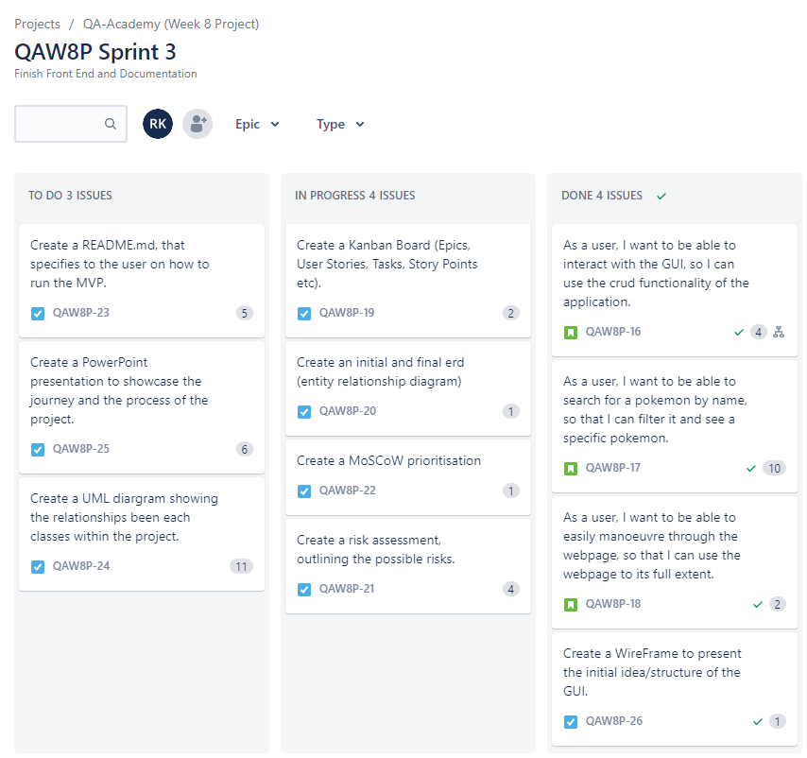
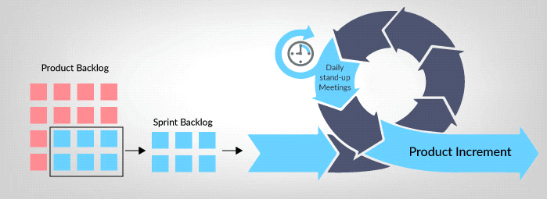
Jira Board – Sprints

Slide 10
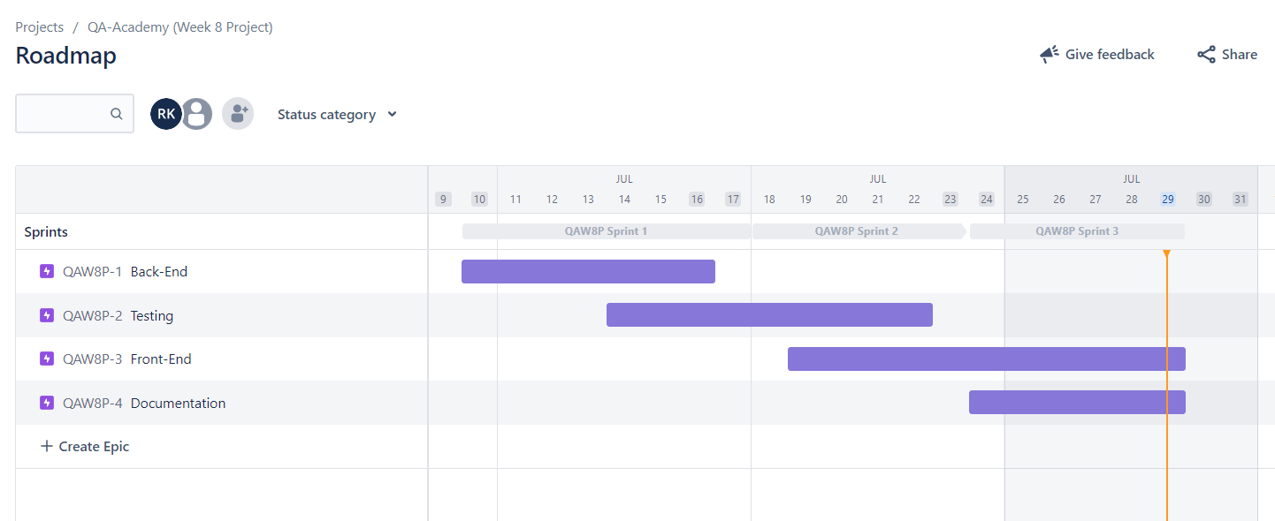
Roadmap

Slide 11
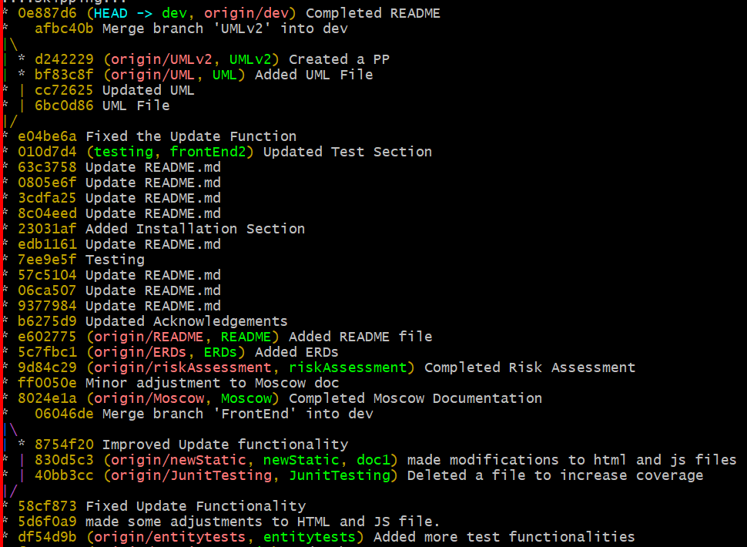
Version Control – Feature Branch Model (FBM)

Slide 12
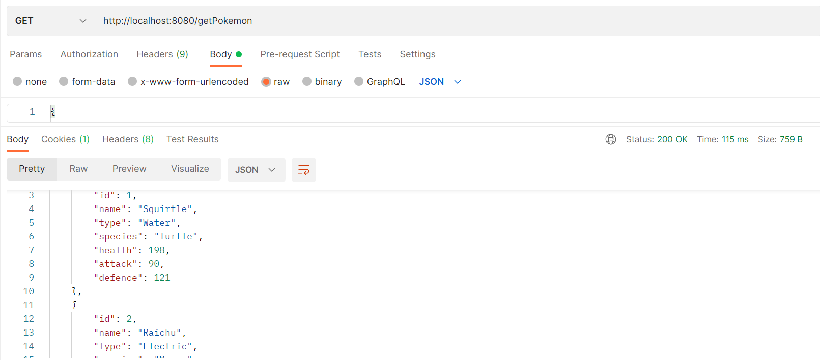
Postman

Slide 13
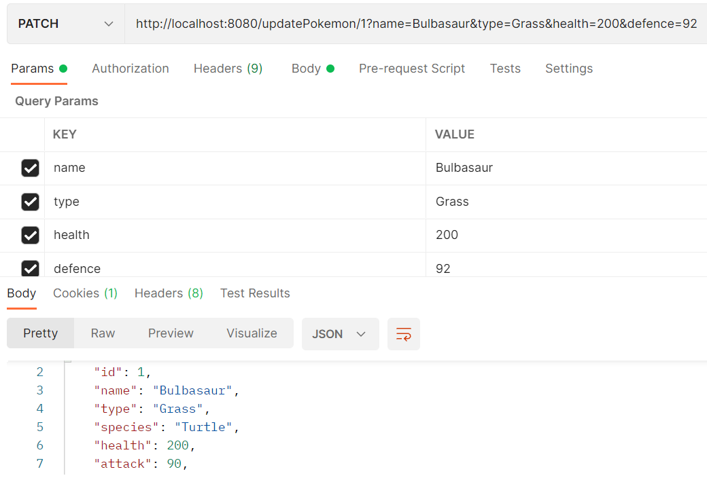
Postman Part 2

Slide 14
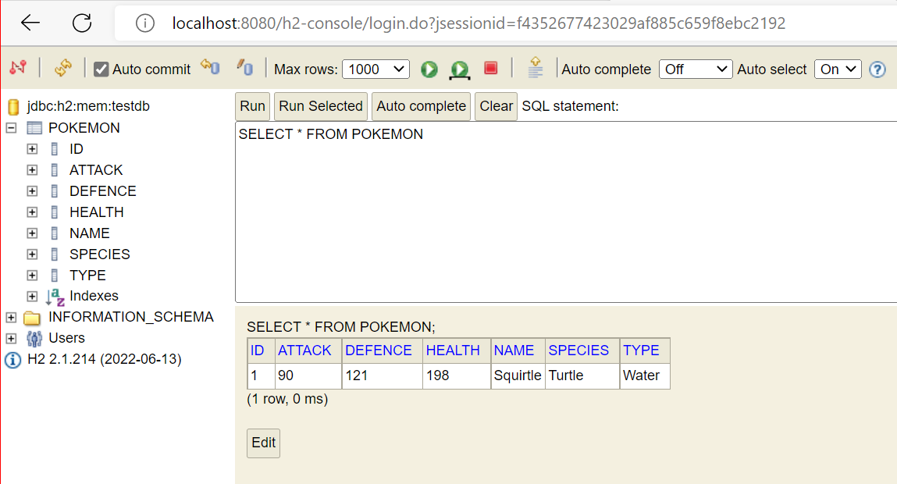
H2 Console

Slide 15
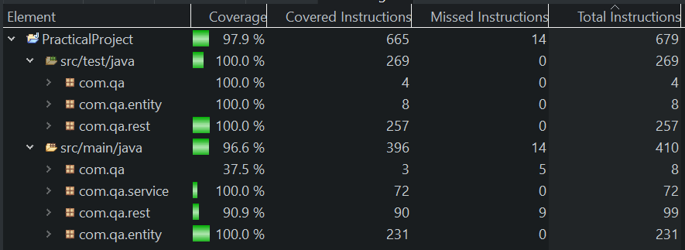
Test Coverage

Slide 16

Demo

Slide 17
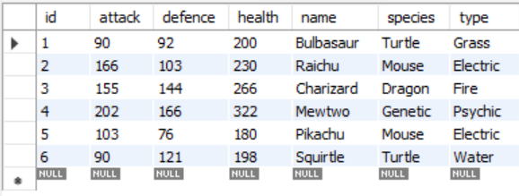
SQL Database

Slide 18

Any Questions?

